Slide 1
计算机视觉 Computer Vision
-- Matching 3
钟 凡
zhongfan@sdu.edu.cn

Slide 2

图像匹配
特征检测
特征匹配
运动估计

Slide 3
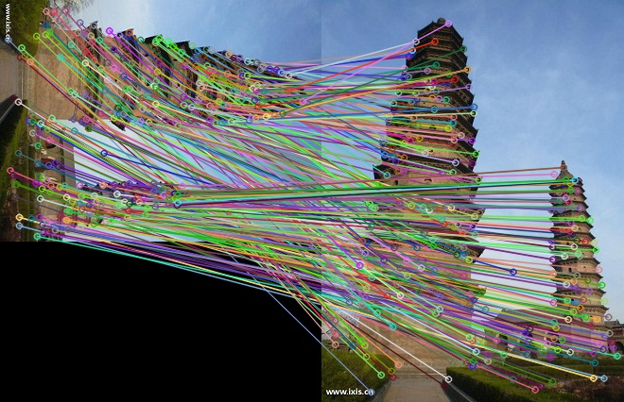
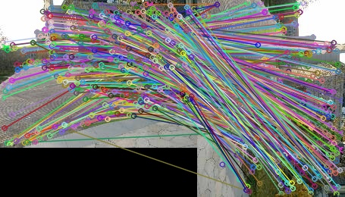
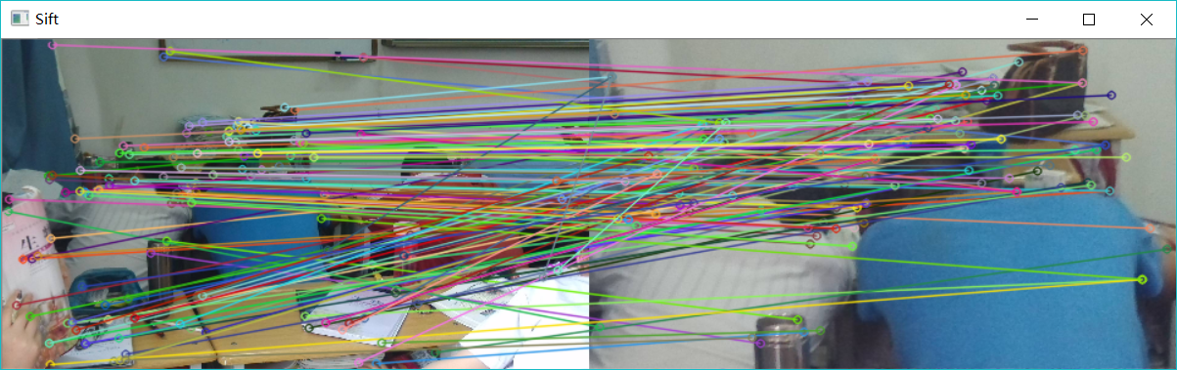
特征检测+匹配

Slide 4
运动估计（图像配准/Alignment）

Slide 5
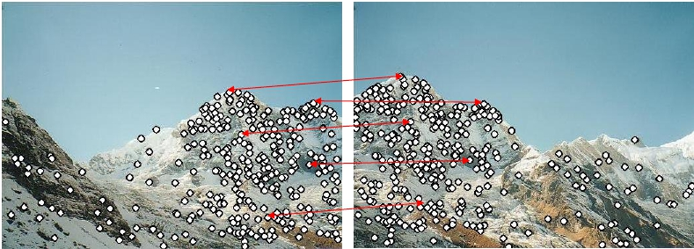
忽略外点(Outlier)
假设特征点匹配都基本正确
?

Slide 6
参数化运动模型

Slide 7
Homogeneous Coordinates & Transform Matrix
homogeneous coordinates:
(齐次坐标)
2D Affine Transform:
（2维仿射变换）
2D Perspective Transform:
（2维透视变换）

Slide 8
仿射变换
Linear Transform：
Affine = Linear + Translation
e.g 2D仿射变换：
把平行直线映射为平行直线

Slide 9
Transform Matrix
Translation (平移)：
Scale (缩放)：
Rotation (旋转)：

Slide 10

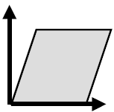
Transform Matrix
X切变（Shear):
Y切变:

Slide 11
如果只有平移….
如何估计最优平移参数 (dx, dy) ?

Slide 12
仿射变换
如何估计变换参数 (a,b,c,d,e,f) ?

Slide 13
估计两副图像之间的仿射变换?

Slide 14
不共线的3个平面点对决定一个二维仿射变换

Slide 15
>3 个点对？

Slide 16
特殊仿射变换
相似变换（Similar)
只包含平移、旋转和等比缩放
保持物体的形状
刚性变换（Rigid)
只包含平移和旋转
保持物体的形状和尺寸

Slide 17
特殊仿射变换
参数化形式与求解???
相似变换（Similar)
只包含平移、旋转和等比缩放
保持物体的形状
刚性变换（Rigid)
只包含平移和旋转
保持物体的形状和尺寸

Slide 18
相似变换

Slide 19
刚性变换

Slide 20
刚性变换
方法1：非线性最小二乘
或者
f(x;p)=Rx+t，其中p是[R, t]矩阵的参数化向量:
刚性变换的雅可比矩阵：

Slide 21
刚性变换
方法2:
方法2：分别求R, t （可以处理任意维度）

Slide 22
仿射变换
线性：
平移
相似
一般仿射变换
非线性：
旋转
刚性

Slide 23
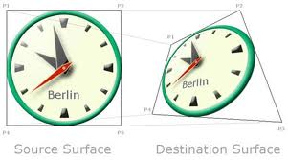
透视变换 (Perspective Transform & Homography)
平面到平面的保持直线性的映射
任意一个3x3可逆矩阵都是透视变换
任意透视变换都可表示为3x3可逆矩阵

Slide 24
透视变换 (Perspective Transform & Homography)
中心投影对应的平面映射是透视变换
场景（三维）中任意平面到图像平面的映射
场景中同一平面在不同视点下图像之间的对应点的映射
旋转相机在不同角度得到的图像之间的映射
中心投影

Slide 25
透视变换估计
8个参数，最少需要4个点对

Slide 26
透视变换估计
方法1：非线性最小二乘

Slide 27
透视变换估计
方法2：直接线性变换（DLT，Direct Linear Transform)

Slide 28
透视变换估计
方法2：直接线性变换（DLT，Direct Linear Transform)

Slide 29
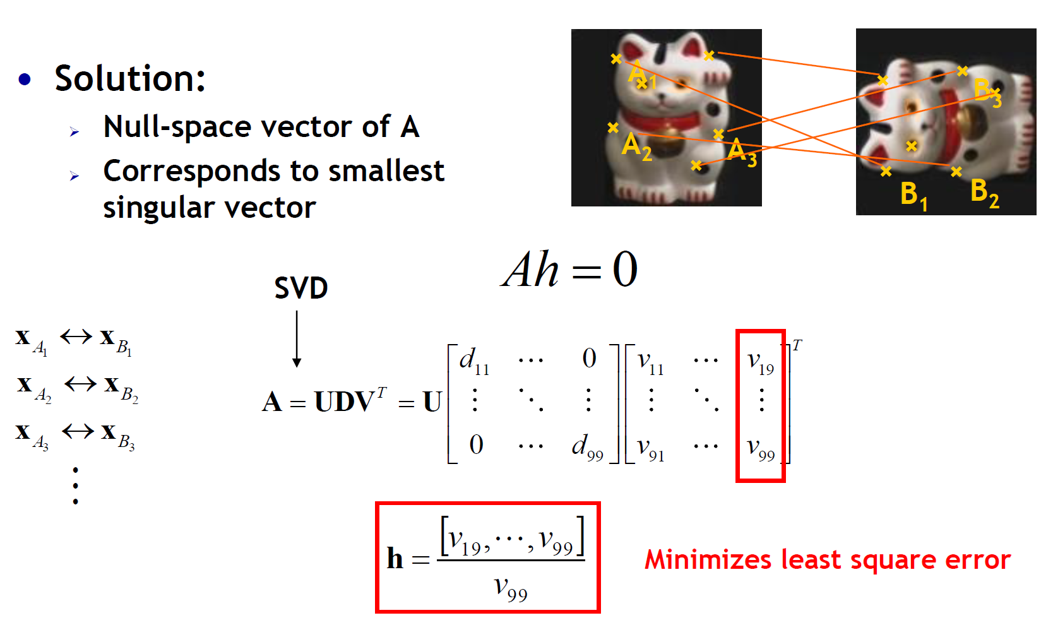
透视变换估计
方法2：直接线性变换（DLT，Direct Linear Transform)

Slide 30
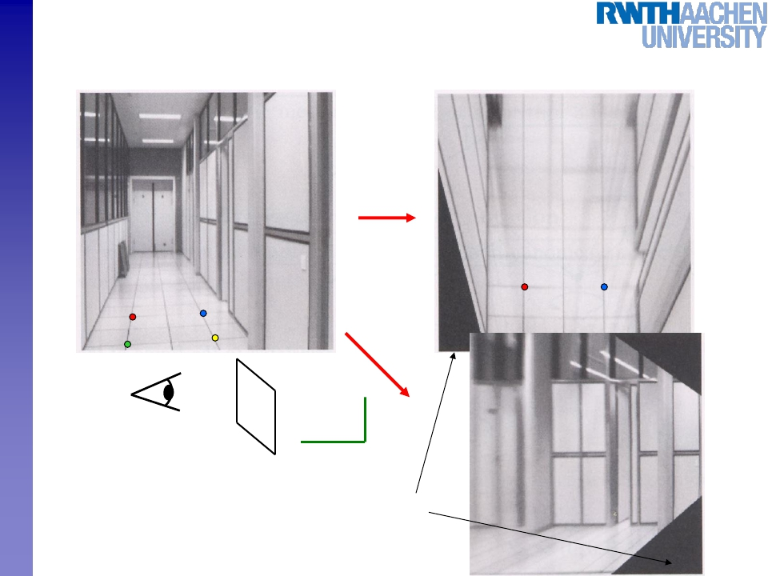
Image Warping with Homographies
p’
image plane below
p
Image plane in front
Sensory Augmented Computing Computer Vision
WS 14/15
Perceptual and
Black area
where no pixel
maps to
B. Leibe
60
Slide credit: Steve Seitz

Slide 31
考虑外点(Outlier)
实际的特征点匹配都可能包含大量的错误

Slide 32
考虑外点(Outlier)
实际的特征点匹配都可能包含大量的错误

Slide 33

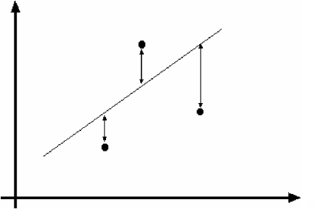
Example: Least-Squares Line Fitting
• Assuming all the points that belong to a particular line
are known
Sensory Augmented Computing Computer Vision
WS 14/15
Perceptual and
65
Source: Forsyth & Ponce
B. Leibe

Slide 34
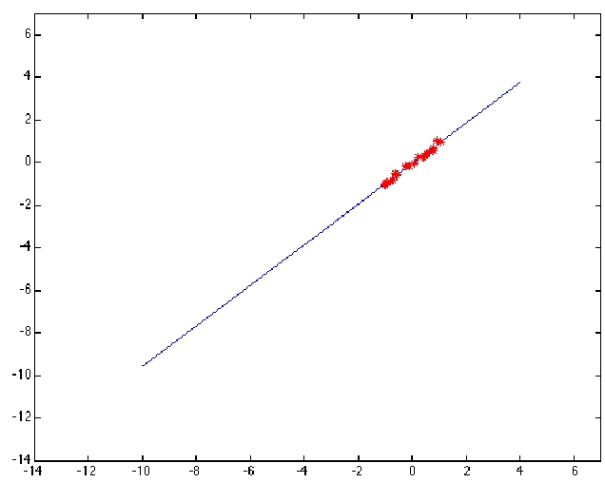
Outliers Affect Least-Squares Fit
Sensory Augmented Computing Computer Vision
WS 14/15
Perceptual and
66
Source: Forsyth & Ponce
B. Leibe

Slide 35
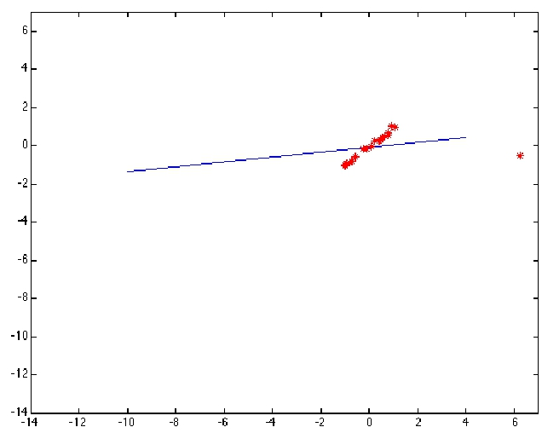
Outliers Affect Least-Squares Fit
Sensory Augmented Computing Computer Vision
WS 14/15
Perceptual and
67
Source: Forsyth & Ponce
B. Leibe

Slide 36
Strategy 1: RANSAC [Fischler81]
• RANdom SAmple Consensus
• Approach: we want to avoid the impact of outliers, so
let’s look for “inliers”, and use only those.
• Intuition: if an outlier is chosen to compute the current
fit, then the resulting line won’t have much support
from rest of the points.
Sensory Augmented Computing Computer Vision
WS 14/15
Perceptual and
68
Slide credit: Kristen Grauman
B. Leibe

Slide 37
RANSAC
RANSAC loop:
1. Randomly select a seed group of points on which to
base transformation estimate (e.g., a group of
matches)
2. Compute transformation from seed group
3. Find inliers to this transformation
4. If the number of inliers is sufficiently large, re-
compute least-squares estimate of transformation on
all of the inliers
• Keep the transformation with the largest number of
inliers
Sensory Augmented Computing Computer Vision
WS 14/15
Perceptual and
69
Slide credit: Kristen Grauman
B. Leibe

Slide 38
RANSAC Line Fitting Example
• Task: Estimate the best line
➢
How many points do we need to estimate the line?
Sensory Augmented Computing Computer Vision
WS 14/15
Perceptual and
70
Slide credit: Jinxiang Chai
B. Leibe

Slide 39
RANSAC Line Fitting Example
• Task: Estimate the best line
Sample two points
Sensory Augmented Computing Computer Vision
WS 14/15
Perceptual and
71
Slide credit: Jinxiang Chai
B. Leibe

Slide 40
RANSAC Line Fitting Example
• Task: Estimate the best line
Fit a line to them
Sensory Augmented Computing Computer Vision
WS 14/15
Perceptual and
72
Slide credit: Jinxiang Chai
B. Leibe

Slide 41
RANSAC Line Fitting Example
• Task: Estimate the best line
Total number of points
within a threshold of
line.
Sensory Augmented Computing Computer Vision
WS 14/15
Perceptual and
73
Slide credit: Jinxiang Chai
B. Leibe

Slide 42
RANSAC Line Fitting Example
• Task: Estimate the best line
“7 inlier points”
Total number of points
within a threshold of
line.
Sensory Augmented Computing Computer Vision
WS 14/15
Perceptual and
74
Slide credit: Jinxiang Chai
B. Leibe

Slide 43
RANSAC Line Fitting Example
• Task: Estimate the best line
Repeat, until we get a
good result.
Sensory Augmented Computing Computer Vision
WS 14/15
Perceptual and
75
Slide credit: Jinxiang Chai
B. Leibe

Slide 44
RANSAC Line Fitting Example
• Task: Estimate the best line
“11 inlier points”
Repeat, until we get a
good result.
Sensory Augmented Computing Computer Vision
WS 14/15
Perceptual and
76
Slide credit: Jinxiang Chai
B. Leibe

Slide 45
RANSAC: How many samples?
• How many samples are needed?
➢
➢
➢
Suppose w is fraction of inliers (points from line).
n points needed to define hypothesis (2 for lines)
k samples chosen.
• Prob. that a single sample of n points is correct:
• Prob. that all k samples fail is: p=
Sensory Augmented Computing Computer Vision
WS 14/15
⇒ Choose k high enough to keep this below desired failure
rate.
Perceptual and
77
Slide credit: David Lowe
B. Leibe

Slide 46
RANSAC: Computed k (p=0.01)
Sensory Augmented Computing Computer Vision
WS 14/15
Perceptual and
78
Slide credit: David Lowe
B. Leibe

Slide 47
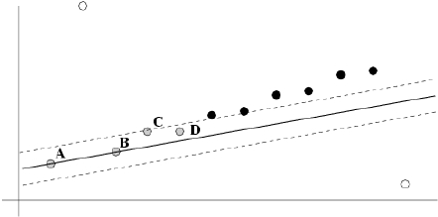
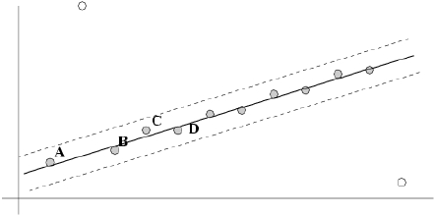
After RANSAC
• RANSAC divides data into inliers and outliers and yields
estimate computed from minimal set of inliers.
• Improve this initial estimate with estimation over all
inliers (e.g. with standard least-squares minimization).
• But this may change inliers, so alternate fitting with re-
classification as inlier/outlier.
Sensory Augmented Computing Computer Vision
WS 14/15
Perceptual and
79
Slide credit: David Lowe
B. Leibe

Slide 48
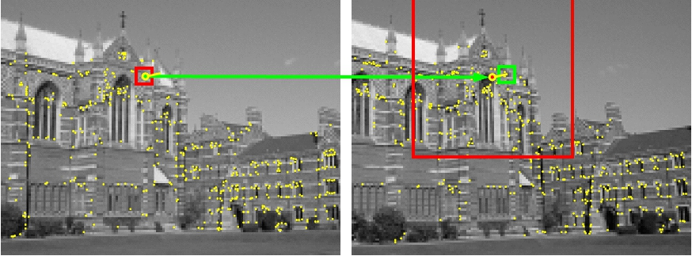
Example: Finding Feature Matches
• Find best stereo match within a square search window
(here 300 pixels2)
• Global transformation model: epipolar geometry
Images from Hartley & Zisserman
Sensory Augmented Computing Computer Vision
WS 14/15
Perceptual and
80
Slide credit: David Lowe
B. Leibe

Slide 49
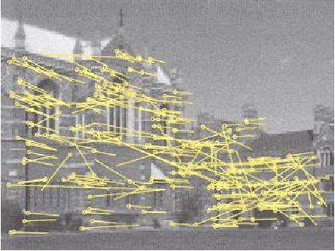
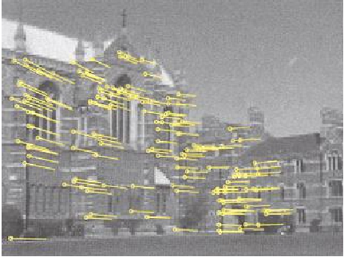
Example: Finding Feature Matches
• Find best stereo match within a square search window
(here 300 pixels2)
• Global transformation model: epipolar geometry
before RANSAC
after RANSAC
Images from Hartley & Zisserman
Sensory Augmented Computing Computer Vision
WS 14/15
Perceptual and
81
Slide credit: David Lowe
B. Leibe

Slide 50
Problem with RANSAC
• In many practical situations, the percentage of outliers
(incorrect putative matches) is often very high (90% or
above).
• The outlier ratio is unknown.
Sensory Augmented Computing Computer Vision
WS 14/15
Perceptual and
82
Slide credit: Svetlana Lazebnik
B. Leibe

Slide 51
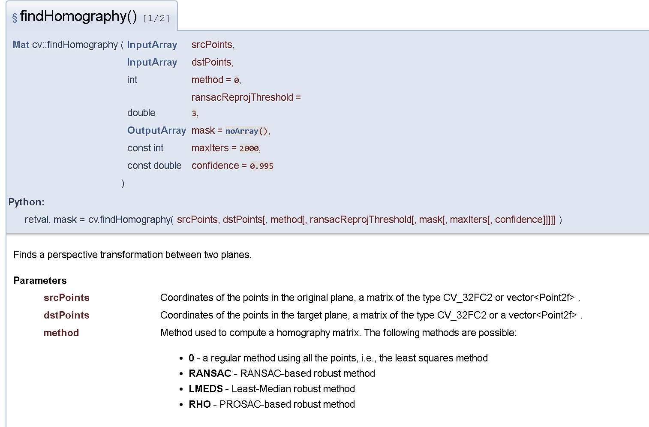
OpenCV相关函数

Slide 52
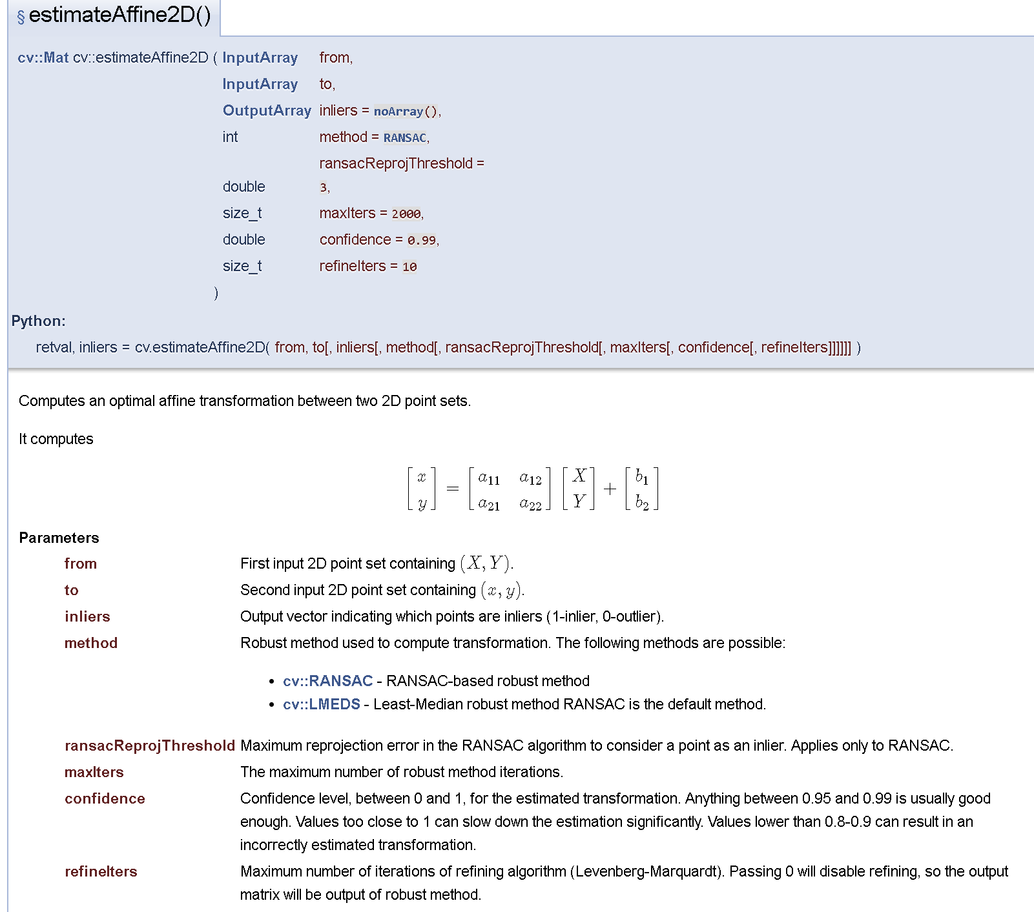

Slide 53
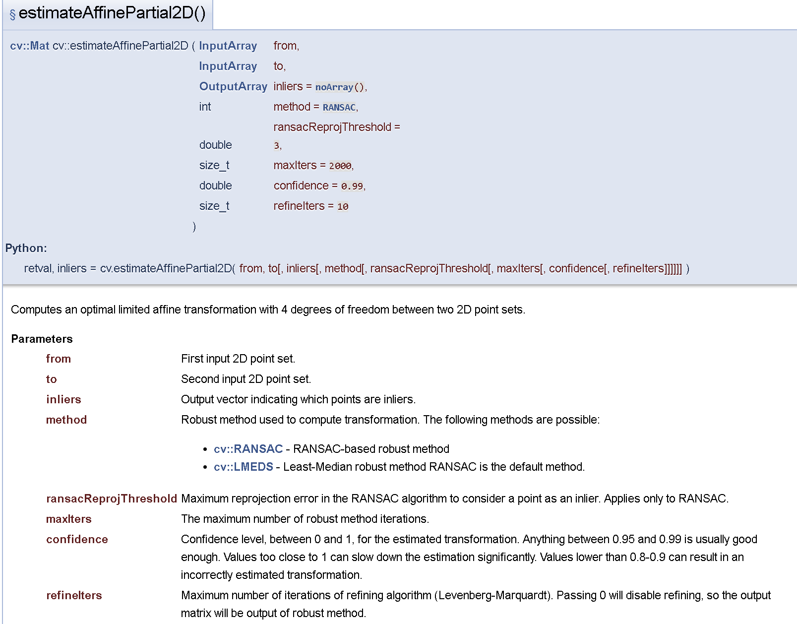
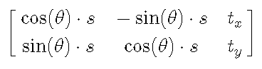
估计相似变换

Slide 54
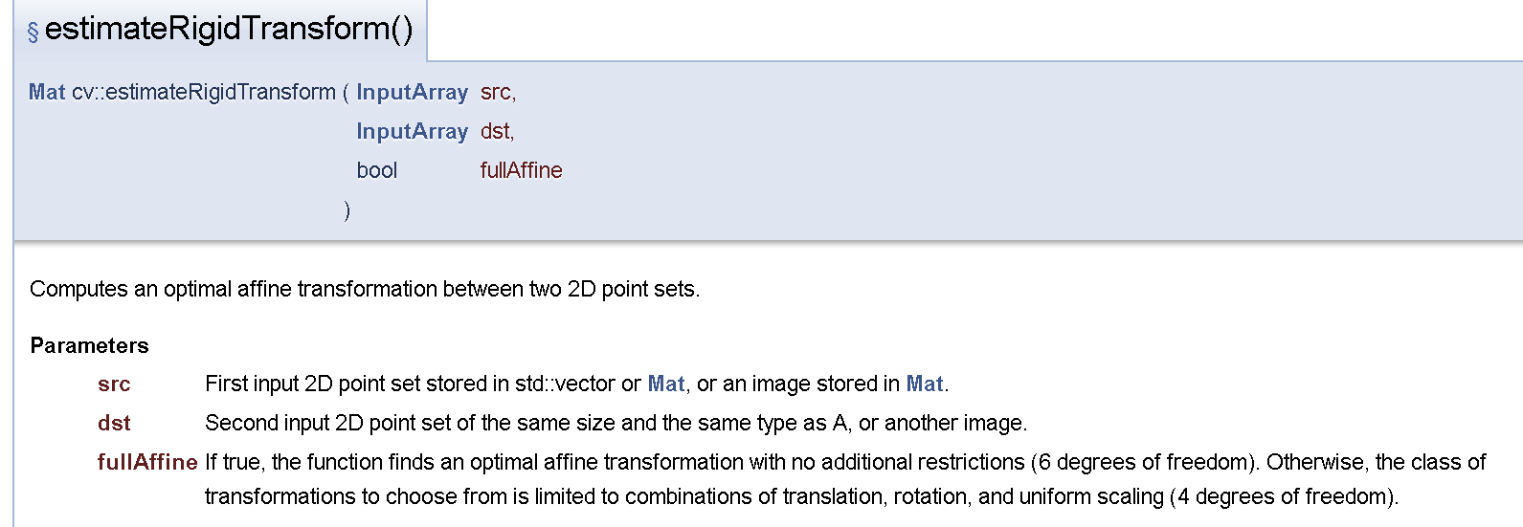
不是刚性变换！

Slide 55
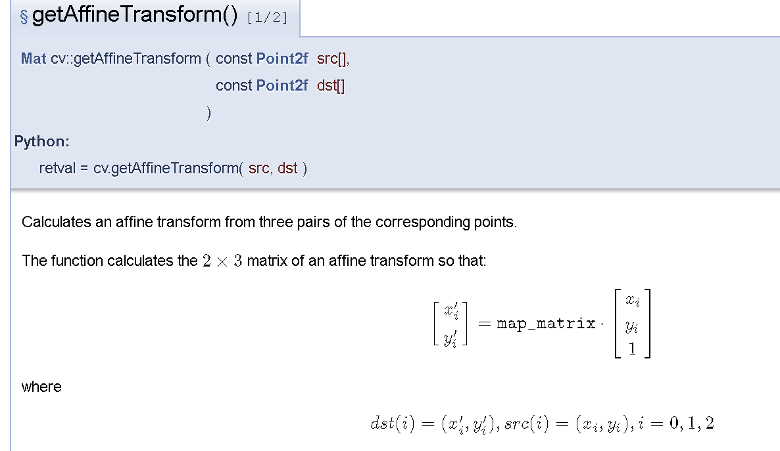

Slide 56
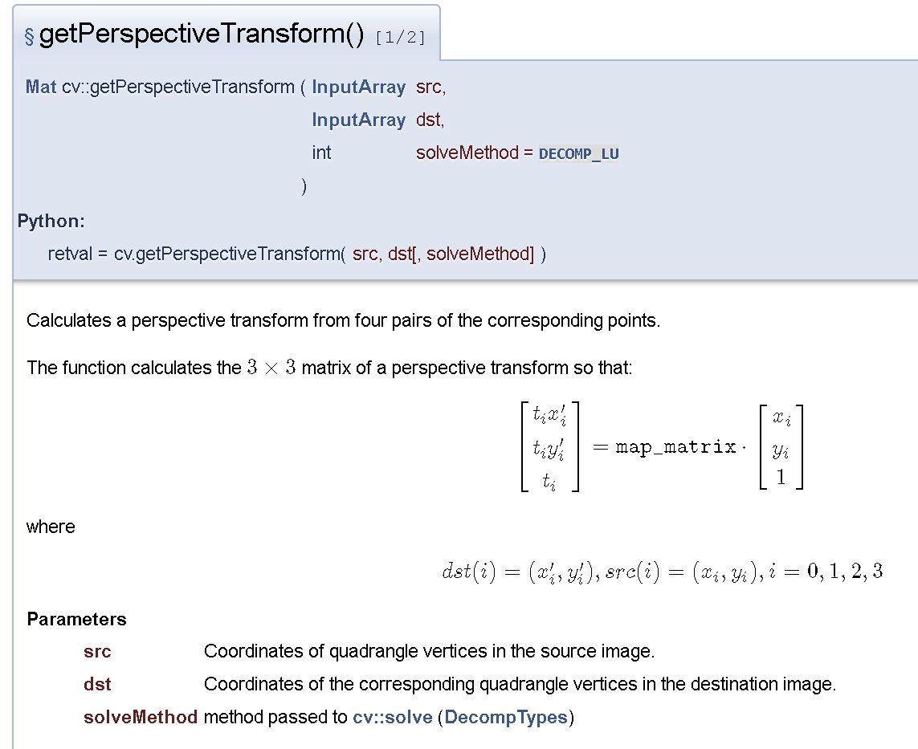

Slide 57
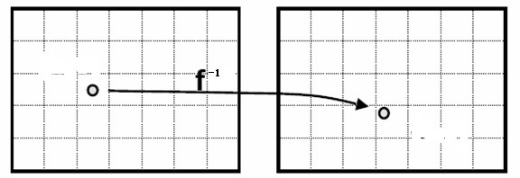
基于变换矩阵对齐图像
Image Warp (变形/卷绕）
D
I

Slide 58
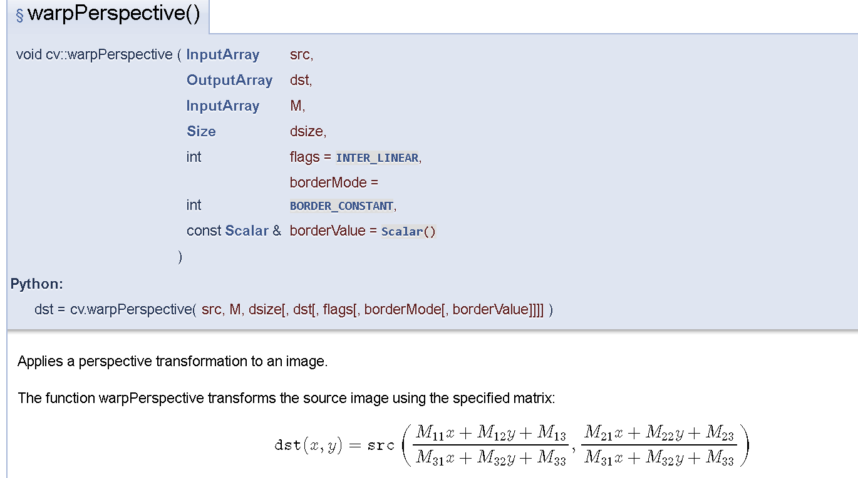

Slide 59
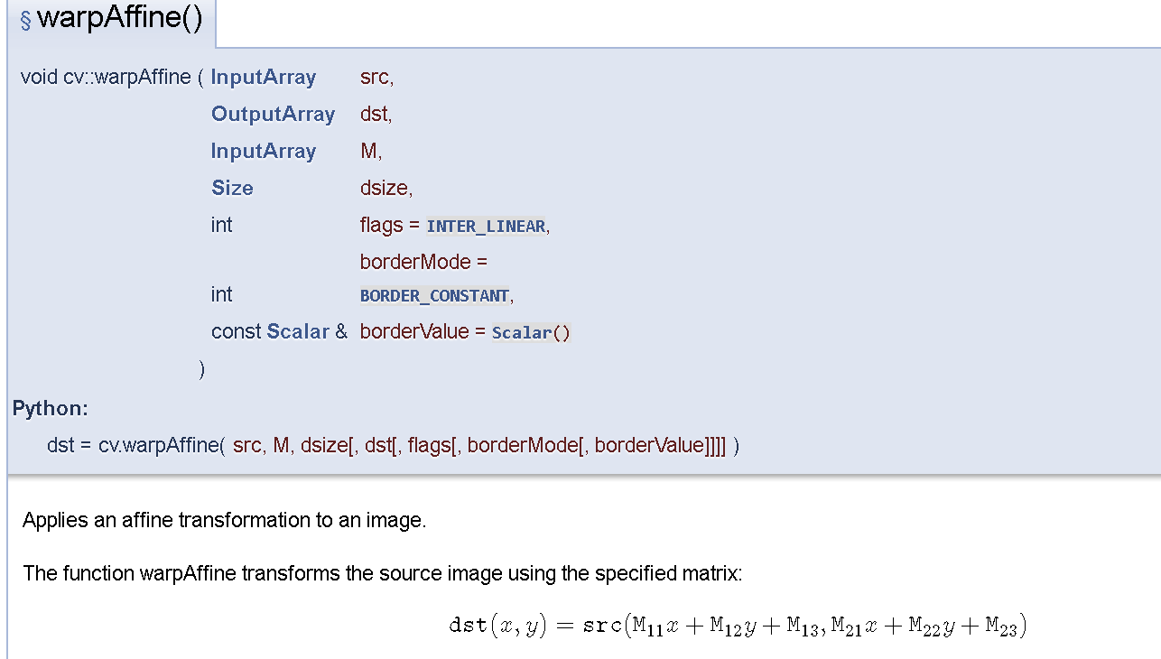

Slide 60
基于匹配的识别

Slide 61
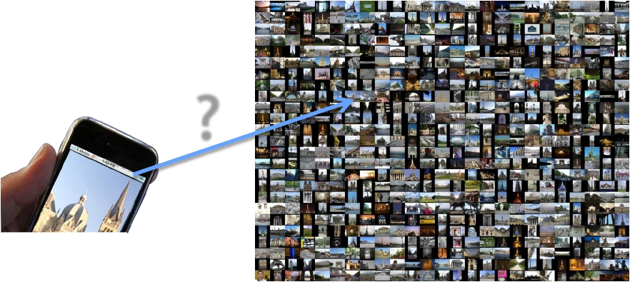
Large-Scale Image Matching Problem
?
Database with thousands (millions) of images
• How can we perform this matching step efficiently?
Sensory Augmented Computing Computer Vision
WS 14/15
Perceptual and
42
B. Leibe

Slide 62
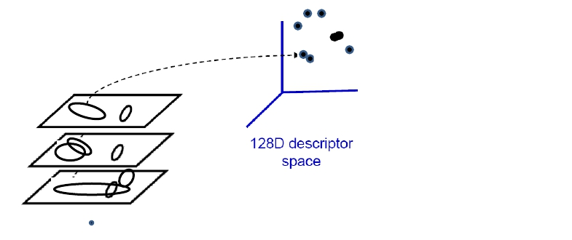
Indexing Local Features
• Each patch / region has a descriptor, which is a point in
some high-dimensional feature space (e.g., SIFT)
Sensory Augmented Computing Computer Vision
WS 14/15
Perceptual and
B. Leibe
Figure credit: A. Zisserman

Slide 63
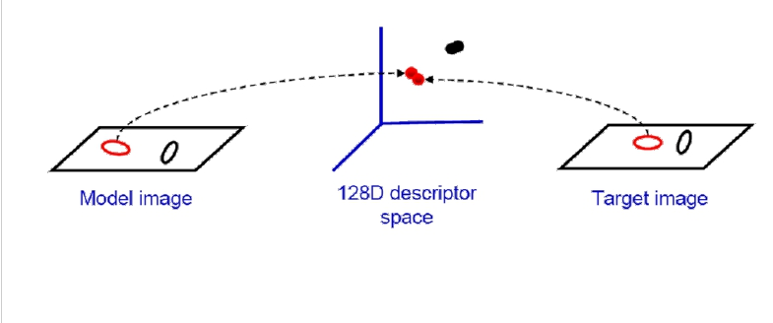
Indexing Local Features
• When we see close points in feature space, we have
similar descriptors, which indicates similar local
content.
• This is of interest for many applications
Sensory Augmented Computing Computer Vision
WS 14/15
Perceptual and
➢
➢
➢
E.g. Image matching,
E.g. Retrieving images of similar objects,
E.g. Object recognition, categorization, 3d Reconstruction,…
B. Leibe
Figure credit: A. Zisserman

Slide 64
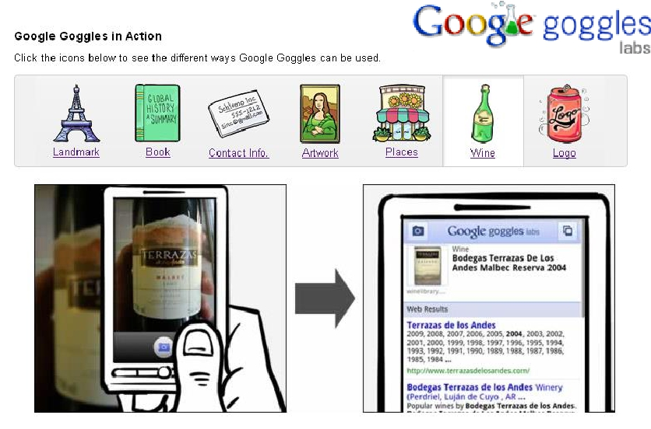
Application: Mobile Visual Search
Sensory Augmented Computing Computer Vision
WS 14/15
Perceptual and
• Take photos of objects as queries for visual search

Slide 65
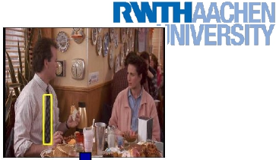
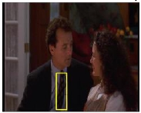
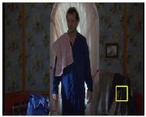
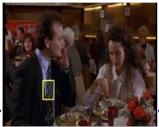
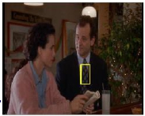
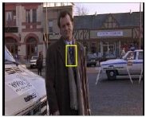
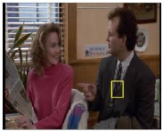
Video Google System
Query
1.
2.
3.
4.
region
Collect all words within query region
Inverted file index to find relevant frames
Compare word counts
Spatial verification
Sivic & Zisserman, ICCV 2003
• Demo online at :
http://www.robots.ox.ac.uk/~vgg/research/vgoogle/index.html
Sensory Augmented Computing Computer Vision
Retrieved frames
WS 14/15
Perceptual and
75
Slide credit: Kristen Grauman
B. Leibe

Slide 66
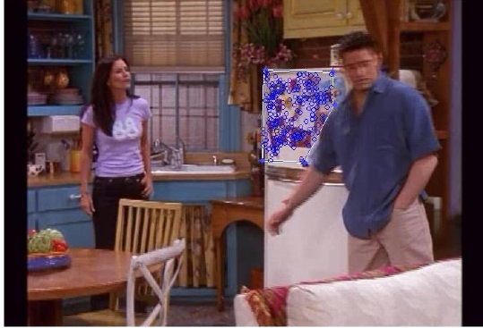
Collecting Words Within a Query Region
• Example: Friends
Query region:
pull out only the SIFT
descriptors whose
positions are within the
polygon
Sensory Augmented Computing Computer Vision
WS 14/15
Perceptual and
76
Slide credit: Kristen Grauman
B. Leibe

Slide 67
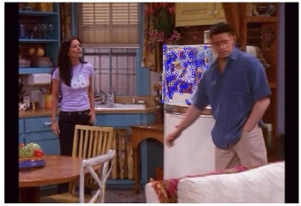
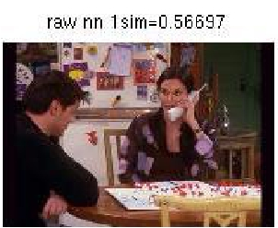
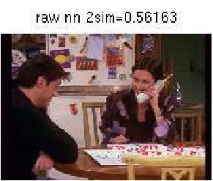
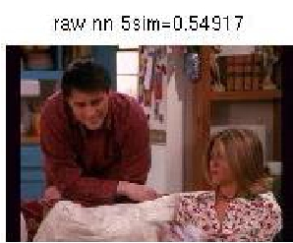
Example Results
Query
Sensory Augmented Computing Computer Vision
WS 14/15
Perceptual and
77
Slide credit: Kristen Grauman
B. Leibe

Slide 68
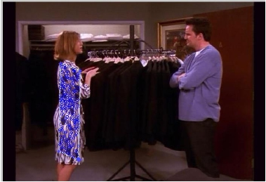
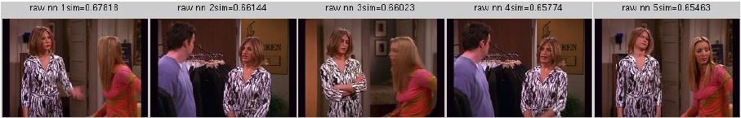
More Results
Query
Retrieved shots
Sensory Augmented Computing Computer Vision
WS 14/15
Perceptual and
78
Slide credit: Kristen Grauman
B. Leibe

Slide 69
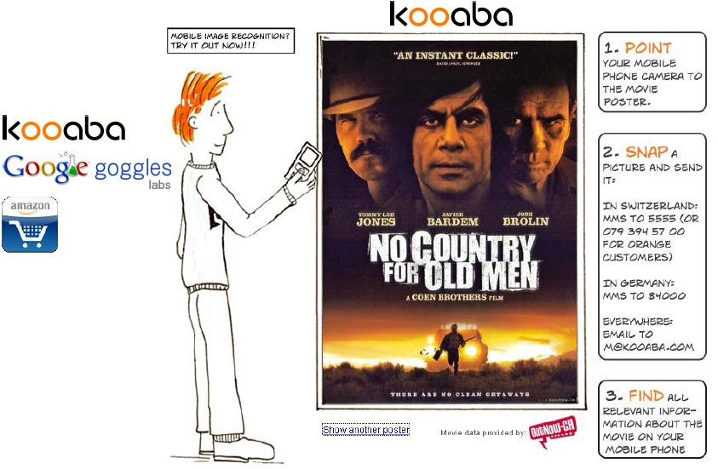
Applications: Specific Object Recognition
• Commercial
services
coming out:
Works well for mostly
planar objects:
- Movie posters,
- Book covers,
- CD/DVD covers,
Sensory Augmented Computing Computer Vision
WS 14/15
Perceptual and
- Video games,
- …
(~20M images indexed)
B. Leibe Source: http://www.kooaba.com
79

Slide 70
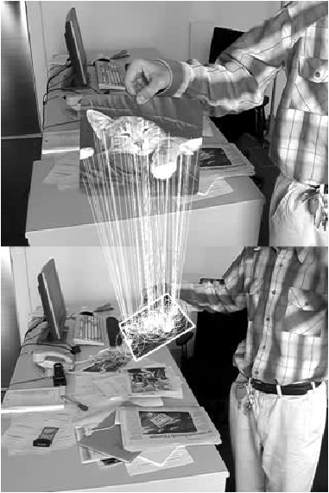
Applications: Fast Image Registration
Sensory Augmented Computing Computer Vision
WS 14/15
Perceptual and
81
B. Leibe

